Slide 1
3. ARMA(p,q) Processes
ECFI 2019-20
Class 18 March 2020

Slide 2

3.1. Autoregressive Processes: AR(p)
Review previous class:
Assume $E\left(Z_{t}\right)=0,$ in order to simplify the notation and discussion
As usual, assume $a_{t}∼wn(0, σ^{2})$, and $φ_{i}$ are real constants
AR(p) process $Z_{t}=φ_{1}Z_{t−1}+φ_{2}Z_{t−2}+…+φ_{p}Z_{t−p}+a_{t}$
or $φ\left(B\right)Z_{t}=a_{t}$
with the AR polynomial $φ\left(B\right)Z_{t}=1−φ_{1}B−…−φ_{p}B^{p}$
As $∑\left|π_{i}\right|=∑\left|φ_{i}\right|<∞$, these processes are always invertible
As we will see later, these processes are stationary (causal) provided all roots of the characteristic equation $φ\left(B\right)=0$ are outside of the unit circle, i.e., if $φ\left(ξ_{i}\right)=0 ⇒{|ξ}_{i}|>1$

Slide 3

Autoregressive Process of order 1: AR(1)
AR(1) process $Z_{t}=φ_{1}Z_{t−1}+a_{t}$
or $\left(1−φB\right)Z_{t}=a_{t}$
This process is stationary provided the root of the characteristic equation $φ\left(B\right)=0$ is outside of the unit circle, i.e., if ${|φ}_{1}|<1$ (verify this).
More general case: nonzero mean. Then, we have a nonzero constant $α$ in the AR equation and we compute the mean (attention: $μ_{z}≠α$!):
$$Z_{t}=α+φ_{1}Z_{t−1}+a_{t}$$
$$E\left[Z_{t}\right]=E\left[α+φ_{1}Z_{t−1}+a_{t}\right]$$
$$E\left[Z_{t}\right]=α+φ_{1}E\left[Z_{t−1}\right]+0$$
Now, as $E\left[Z_{t}\right]=E\left[Z_{t−1}\right]=μ_{z},$ by stationarity, we get
$$μ_{Z}=E\left[Z_{t}\right]=\frac{α}{1−φ}$$

Slide 4
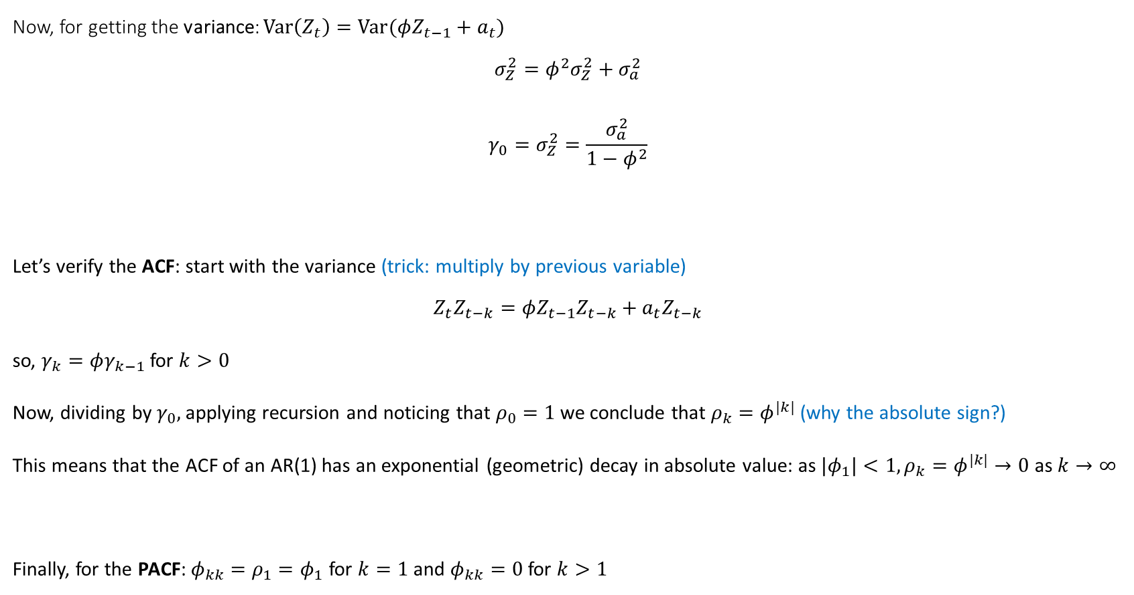
Now, for getting the variance: $Var\left(Z_{t}\right)=Var(φZ_{t−1}+a_{t})$
$$σ_{Z}^{2}=φ^{2}σ_{Z}^{2}+σ_{a}^{2}$$
$$γ_{0}=σ_{Z}^{2}=\frac{σ_{a}^{2}}{1−φ^{2}}$$
Let’s verify the ACF: start with the variance (trick: multiply by previous variable)
$$Z_{t}Z_{t−k}=φZ_{t−1}Z_{t−k}+a_{t}Z_{t−k}$$
so, $γ_{k}=φγ_{k−1}$ for $k>0$
Now, dividing by $γ_{0},$ applying recursion and noticing that $ρ_{0}=1$ we conclude that $ρ_{k}=φ^{|k|}$ (why the absolute sign?)
This means that the ACF of an AR(1) has an exponential (geometric) decay in absolute value: as ${|φ}_{1}|<1, ρ_{k}=φ^{|k|}→0$as $k→∞$
Finally, for the PACF: $φ_{kk}=ρ_{1}=φ_{1}$ for $k=1$ and $φ_{kk}=0$ for $k>1$

Slide 5
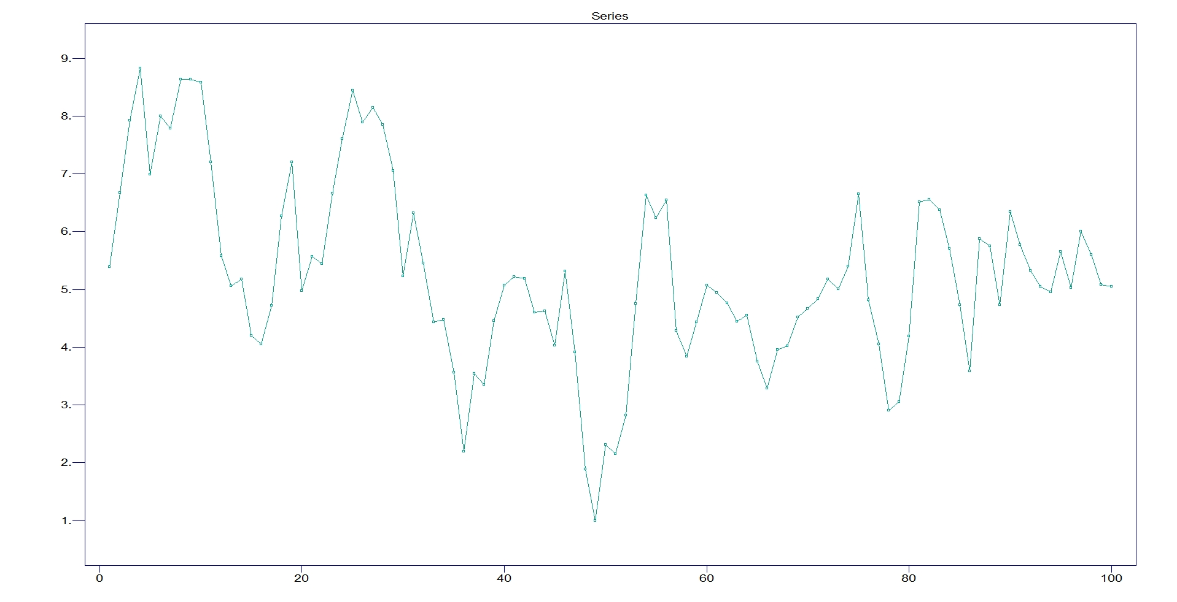
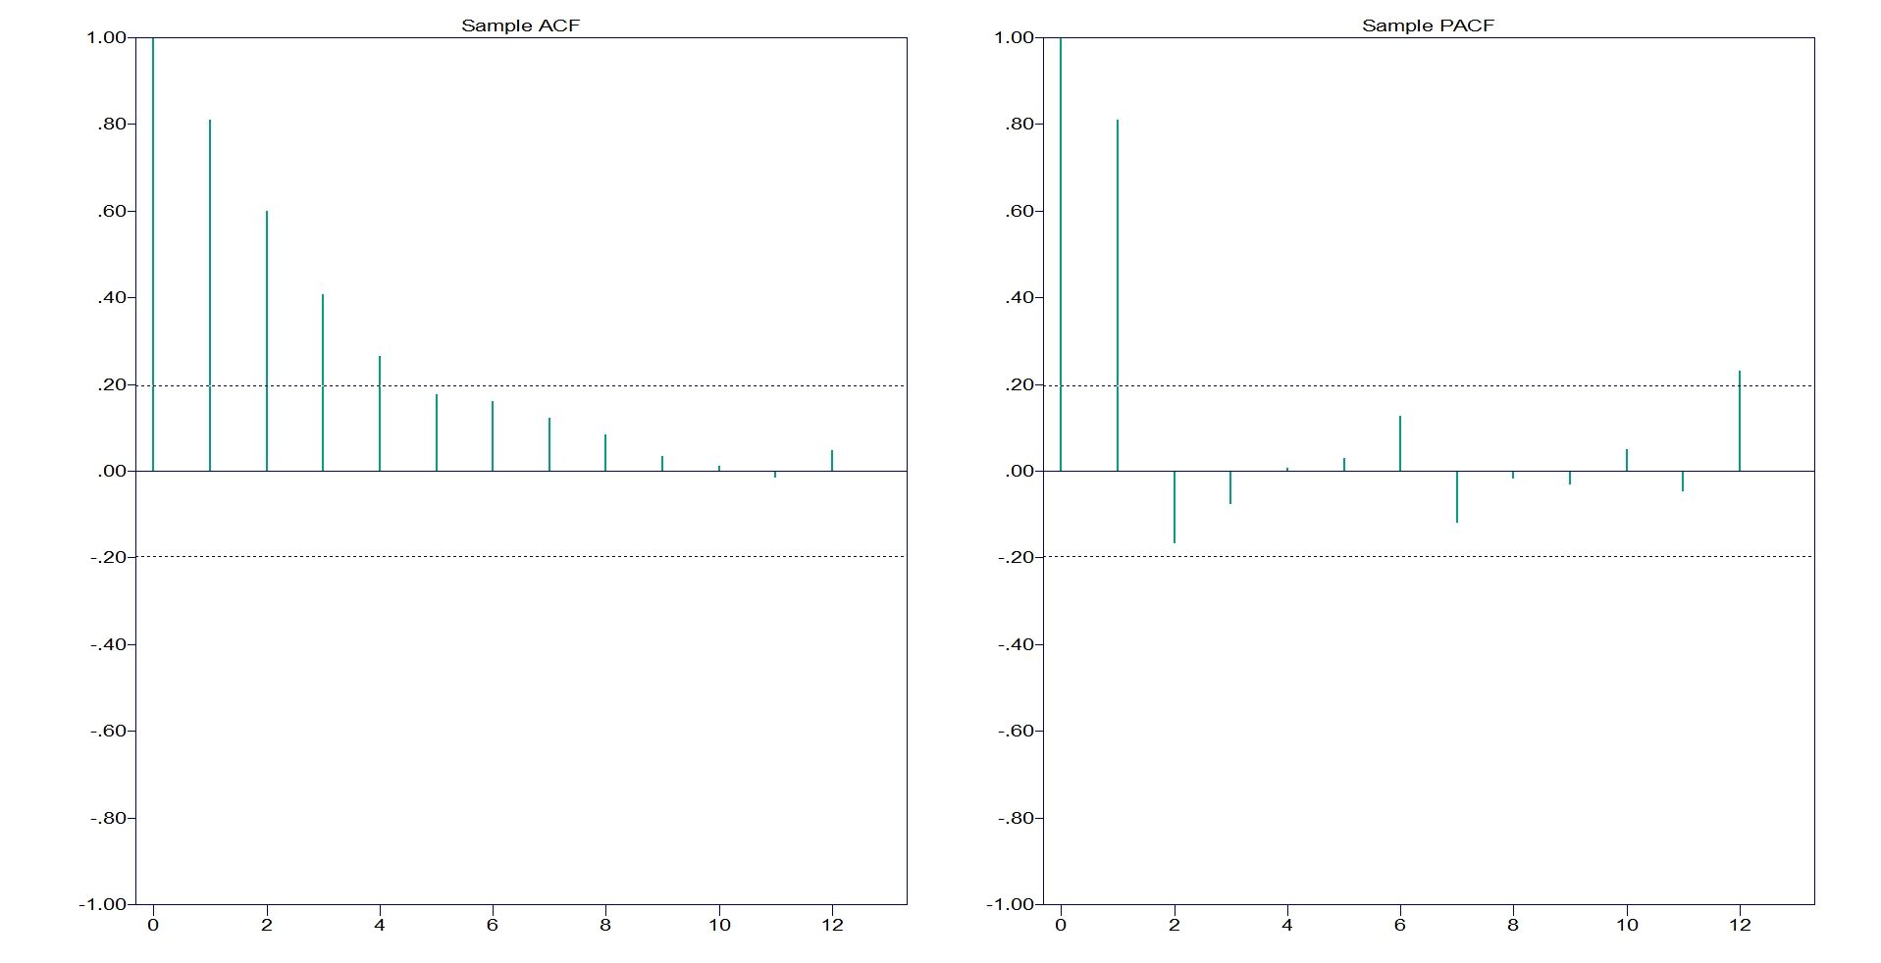
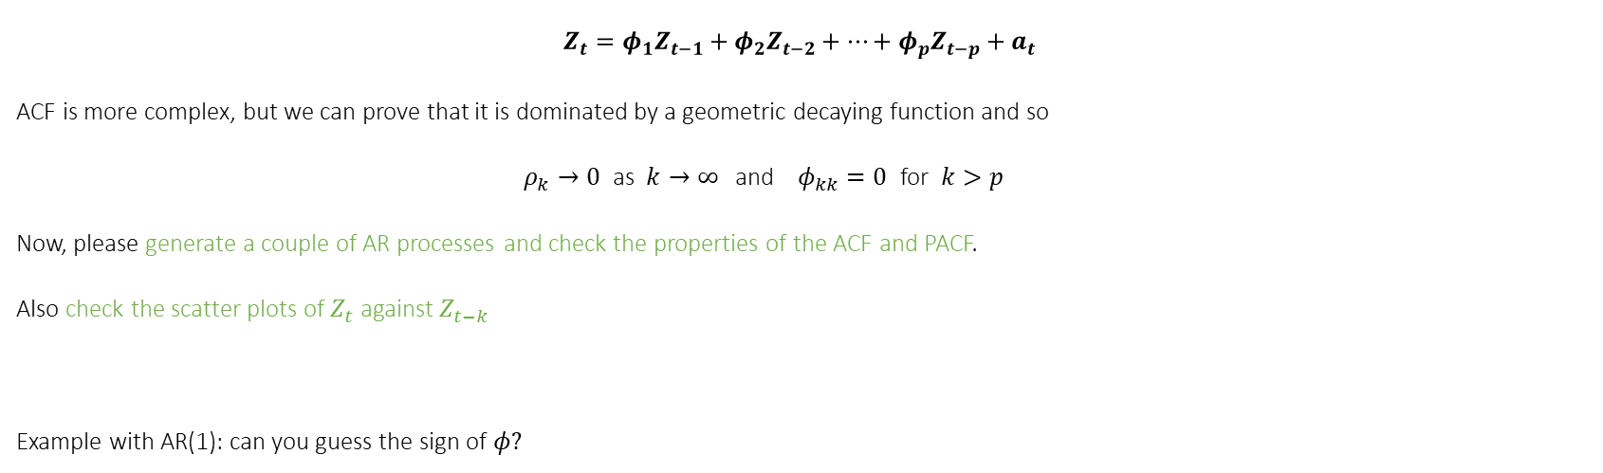
Autoregressive Process of order q: AR(q)
$$Z_{t}=φ_{1}Z_{t−1}+φ_{2}Z_{t−2}+…+φ_{p}Z_{t−p}+a_{t}$$
ACF is more complex, but we can prove that it is dominated by a geometric decaying function and so
$ρ_{k}→0$ as $k→∞$and $φ_{kk}=0$ for $k>p$
Now, please generate a couple of AR processes and check the properties of the ACF and PACF.
Also check the scatter plots of $Z_{t}$ against $Z_{t−k}$
Example with AR(1): can you guess the sign of $φ?$

Slide 6
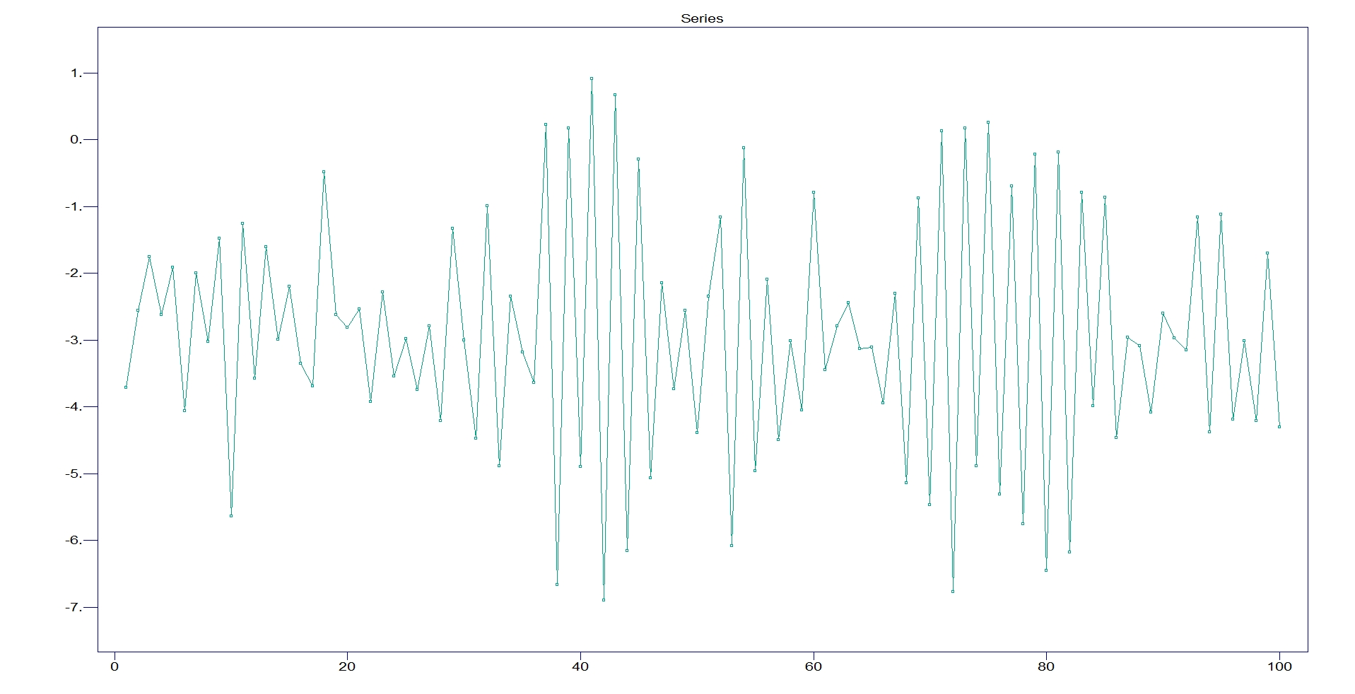
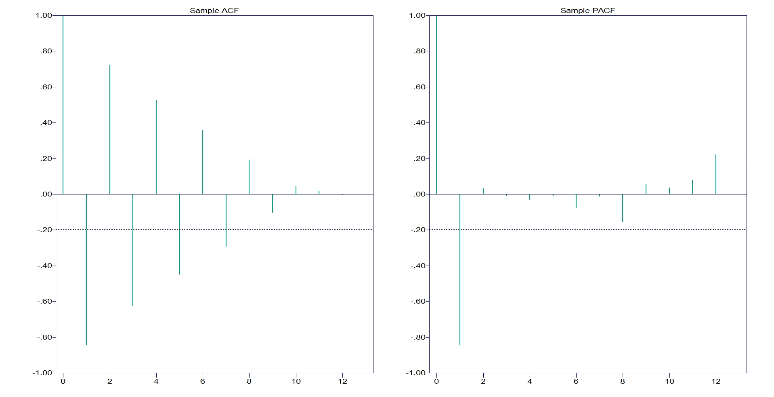
Another AR(1): Guess the sign of $φ$

Slide 7
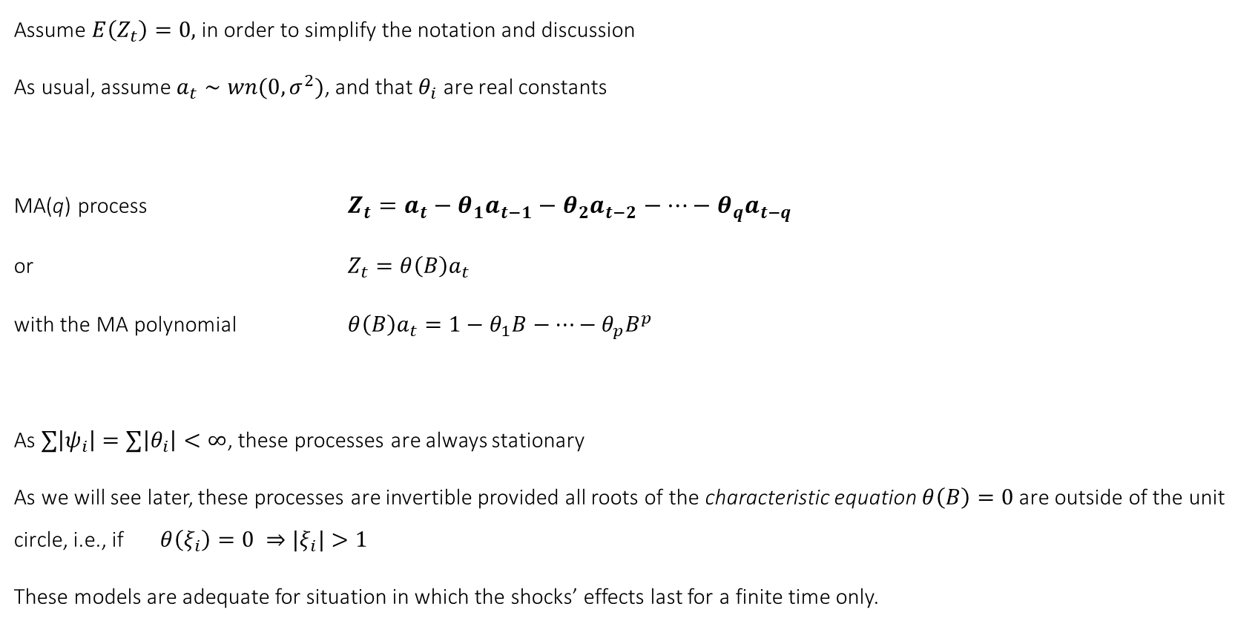
3.2. Moving Average Processes: MA(q)
Assume $E\left(Z_{t}\right)=0,$ in order to simplify the notation and discussion
As usual, assume $a_{t}∼wn(0, σ^{2})$, and that $θ_{i}$ are real constants
MA(q) process $Z_{t}=a_{t}−θ_{1}a_{t−1}−θ_{2}a_{t−2}−…−θ_{q}a_{t−q}$
or $Z_{t}=θ\left(B\right)a_{t}$
with the MA polynomial $θ\left(B\right)a_{t}=1−θ_{1}B−…−θ_{p}B^{p}$
As $∑\left|ψ_{i}\right|=∑\left|θ_{i}\right|<∞$, these processes are always stationary
As we will see later, these processes are invertible provided all roots of the characteristic equation $θ\left(B\right)=0$ are outside of the unit circle, i.e., if $θ\left(ξ_{i}\right)=0 ⇒{|ξ}_{i}|>1$
These models are adequate for situation in which the shocks’ effects last for a finite time only.

Slide 8

Moving Average Process of order 1: MA(1)
MA(1) process $Z_{t}={a_{t} −θ}_{1}a_{t−1}$
or $Z_{t}=\left(1−θ_{1}B\right)a_{t}$
This process is invertible provided the root of the characteristic equation $θ\left(B\right)=0$ is outside of the unit circle, i.e., if ${|θ}_{1}|<1$
Let’s verify the ACF (trick: multiply by previous variable)
$$γ_{0}=\left(1+θ_{1}^{2}\right)σ_{a}^{2}$$
$$γ_{1}=−θ_{1}σ_{a}^{2}$$
$γ_{k}=0$ for $k>0$ (vanishes after order 1)
And the PACF:
$φ_{kk}=\frac{−θ_{1}^{k}(1−θ_{1}^{2})}{1−θ_{1}^{2(k+1)}}$ (never vanishes)

Slide 9
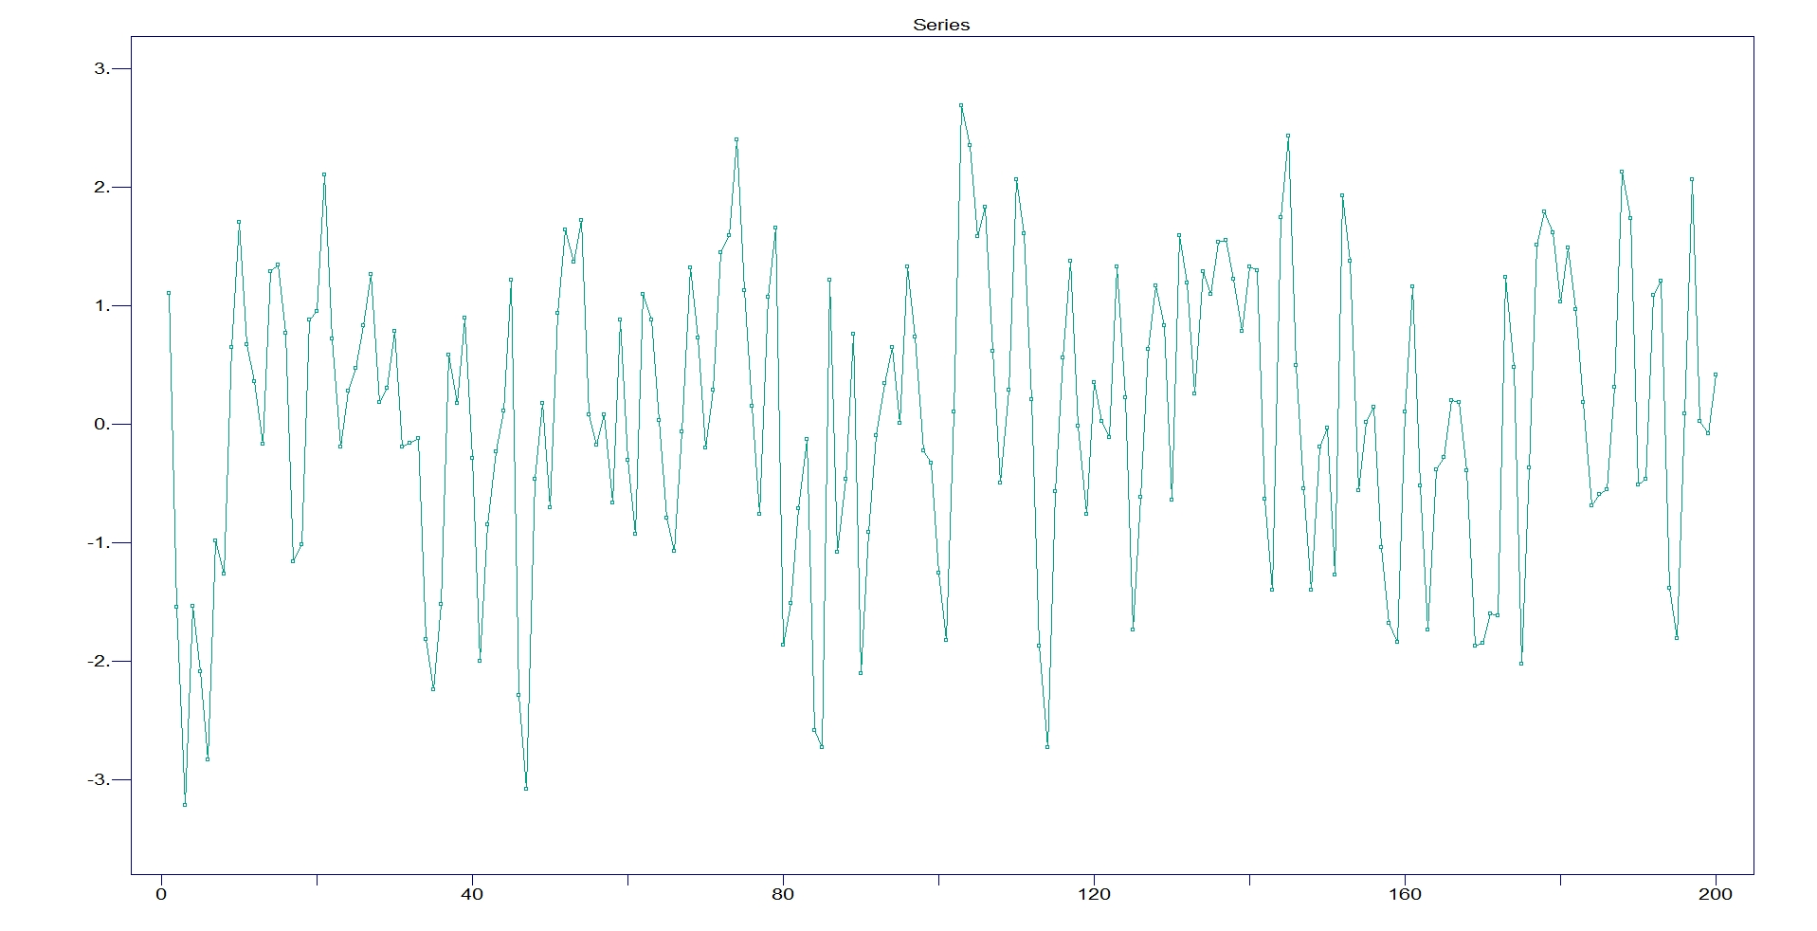
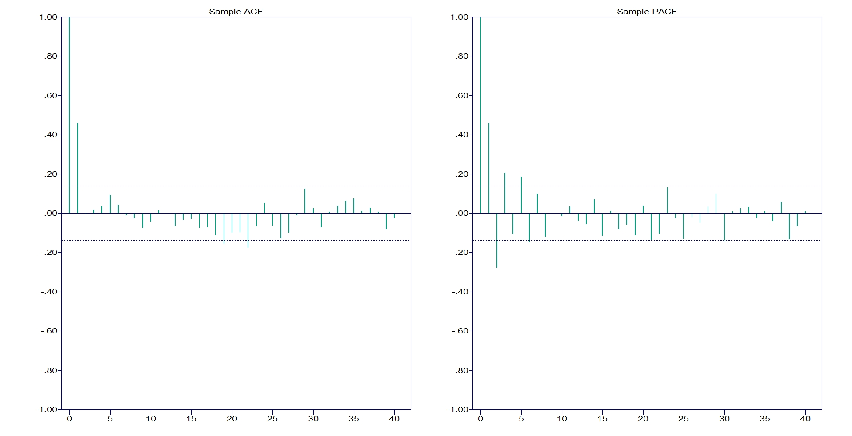
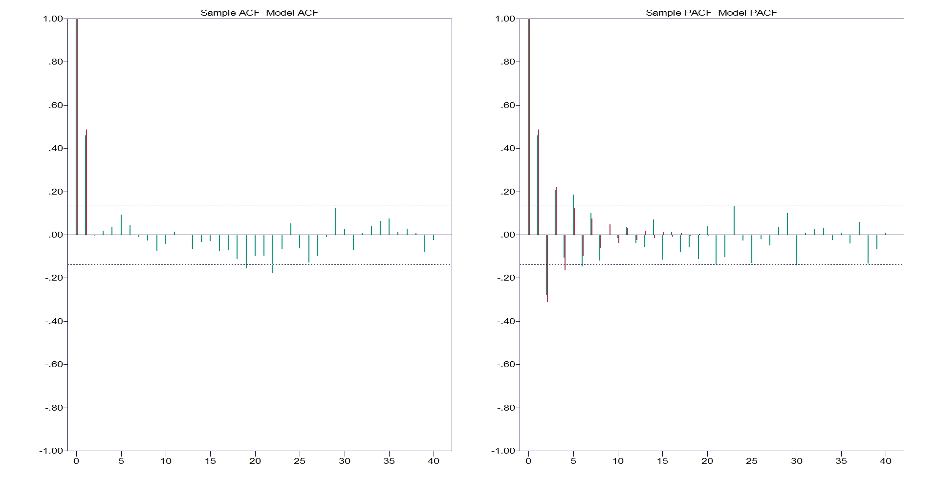
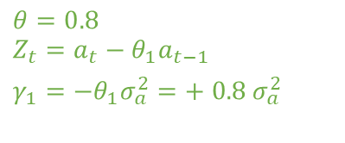
An MA (1): Guess the sign of $θ$
$$θ=0.8$$
$$Z_{t}={a_{t}−θ}_{1}a_{t−1}$$
$γ_{1}=−θ_{1}σ_{a}^{2}=+ 0.8 σ_{a}^{2}$

Slide 10

Moving Average Process of order q: MA(q)
MA(q) process $Z_{t}={a_{t} −θ}_{1}a_{t−1}−θ_{2}a_{t−2}−…−θ_{q}a_{t−q}$
or $Z_{t}=\left(1−θ_{1}B−θ_{2}B^{2}−…−θ_{q}B^{q}\right)a_{t}$
This process is invertible provided the roots of the characteristic equation $θ\left(B\right)=0$ are all outside of the unit circle
Let’s verify the ACF (trick: multiply by previous variable)
$$γ_{0}=\left(1+θ_{1}^{2}+..+θ_{q}^{2}\right) σ_{a}^{2}$$
$$γ_{k}=\left(−θ_{k}+θ_{1}^{}θ_{k+1}+… +θ_{q−k}^{}θ_{q}\right) σ_{a}^{2}$$
$γ_{k}=0$ for $k>q$ (vanishes after order q)
And the PACF for the MA(1):
$φ_{kk}=\frac{−θ_{1}^{k}(1−θ_{1}^{2})}{1−θ_{1}^{2(k+1)}}$ (never vanishes)

Slide 11

3.3. Duality AR-MA
C$ontinue to assume E\left(Z_{t}\right)=0,$ in order to simplify the notation and discussion
Consider a stationary (causal) AR(p) with the AR polynomial$φ\left(B\right)Z_{t}=1−φ_{1}B−…−φ_{p}B^{p}$.
By successive formal manipulations
$φ\left(B\right)Z_{t}=a_{t}$
$Z_{t}=φ{\left(B\right)}^{−1}a_{t}=(1+ψ_{1}B+$ $ψ_{2}B^{2}+…{)a}_{t}=ψ\left(B\right)a_{t}$
So, we wrote the AR(p) finite polynomial as an infinite MA($∞$) polynomial
Two ways for computing the $ψ_{i}$ coefficients for the Wold MA($∞$) representation:
- Getting the roots of the AR polynomial, factor it, and use the formula ${\left(1−x\right)}^{−1}=1+x+x^{2}+…$,
- By the method of undetermined coefficients
Practice both ways for an AR(2) process

Slide 12
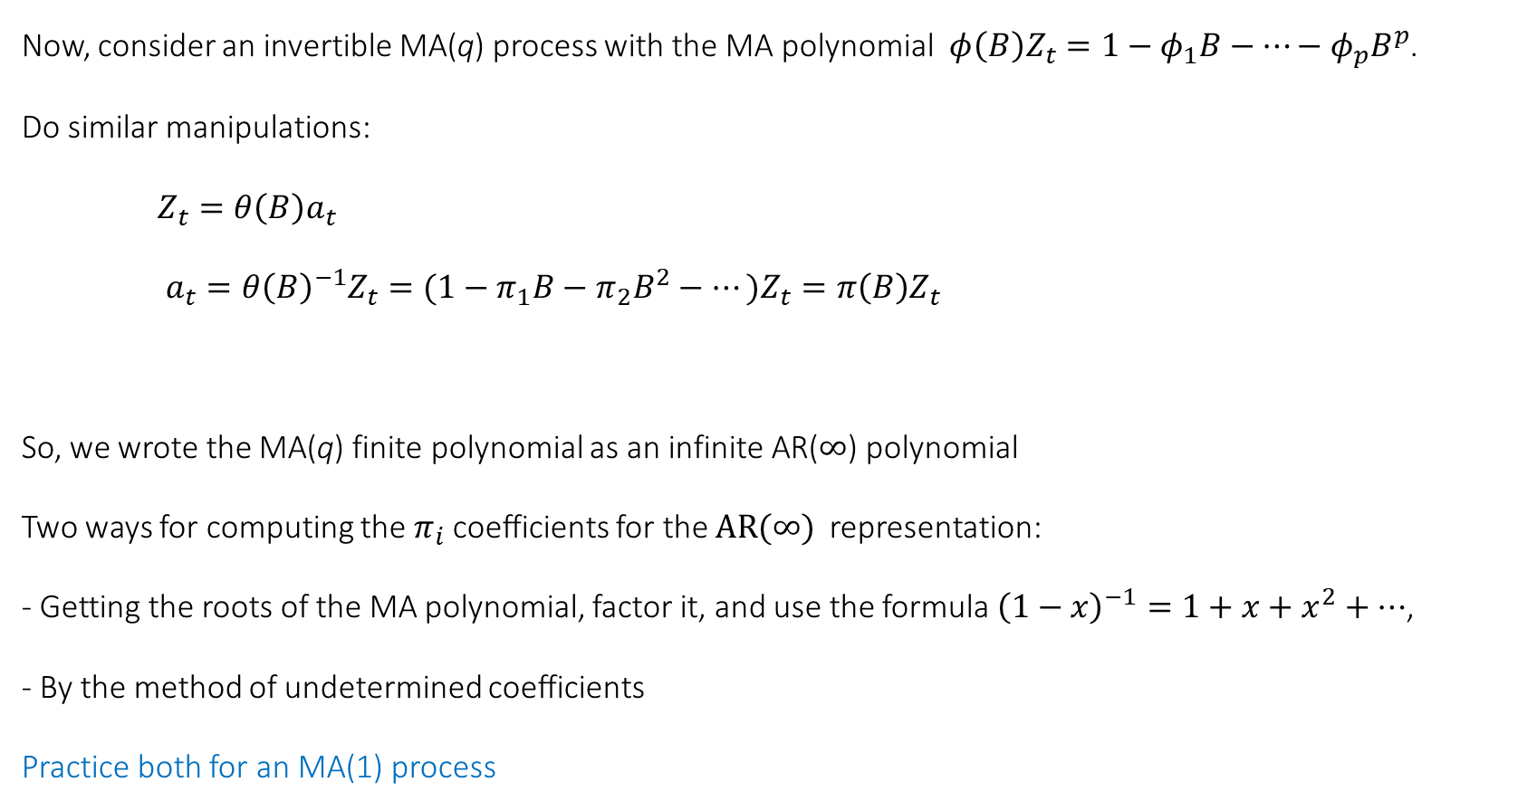
Now, consider an invertible MA(q) process with the MA polynomial$φ\left(B\right)Z_{t}=1−φ_{1}B−…−φ_{p}B^{p}$.
Do similar manipulations:
$Z_{t}={θ\left(B\right)a}_{t}$
$a_{t}=θ{\left(B\right)}^{−1}Z_{t}=(1−π_{1}B−$ $π_{2}B^{2}−…{)Z}_{t}=π\left(B\right)Z_{t}$
So, we wrote the MA(q) finite polynomial as an infinite AR($∞$) polynomial
Two ways for computing the $π_{i}$ coefficients for the $AR(∞)$representation:
- Getting the roots of the MA polynomial, factor it, and use the formula ${\left(1−x\right)}^{−1}=1+x+x^{2}+…$,
- By the method of undetermined coefficients
Practice both for an MA(1) process

Slide 13
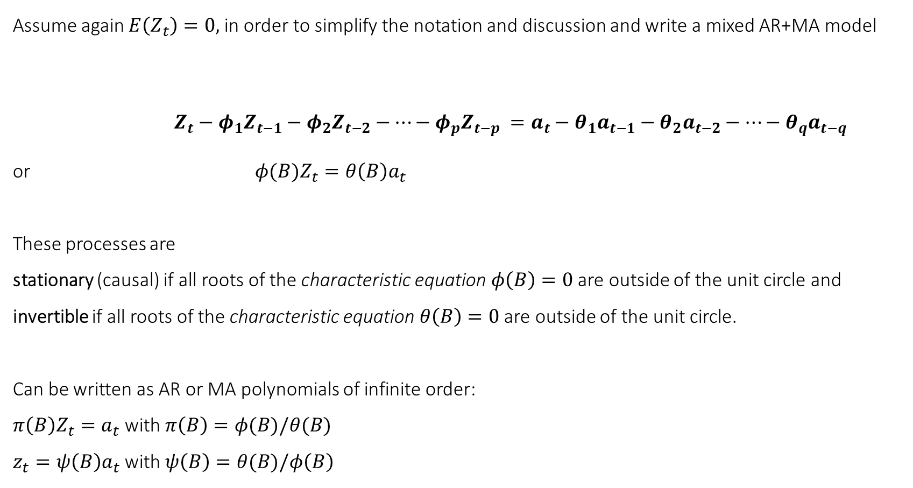
3.4. Autoregressive Moving Average Processes – ARMA(p,q)
Assume again $E\left(Z_{t}\right)=0,$ in order to simplify the notation and discussion and write a mixed AR+MA model
$Z_{t}−φ_{1}Z_{t−1}−φ_{2}Z_{t−2}−…−φ_{p}Z_{t−p} =a_{t}−θ_{1}a_{t−1}−θ_{2}a_{t−2}−…−θ_{q}a_{t−q}$
or ${φ(B)Z}_{t}=θ\left(B\right)a_{t}$
These processes are
stationary (causal) if all roots of the characteristic equation $φ\left(B\right)=0$ are outside of the unit circle and
invertible if all roots of the characteristic equation $θ\left(B\right)=0$ are outside of the unit circle.
Can be written as AR or MA polynomials of infinite order:
$π\left(B\right)Z_{t}=a_{t}$ with $π\left(B\right)=φ(B)/θ(B)$
$z_{t}=ψ\left(B\right)a_{t}$ with $ψ\left(B\right)=θ(B)/φ\left(B\right)$

Slide 14
An ARMA (1,2): complex behaviour: $Z_{t}=0.83Z_{t−1}+a_{t}−0.49a_{t−1}+0.78a_{t−2}$

Slide 15
